Slide 1
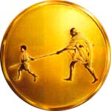
Value Added Course
MGM BLS
Mahatma Gandhi Mission
MGM
SKILLS LAB

Slide 2




AMERICAN COLLEGE OF SURGEONS AND ATLS(I) ACCREDIATED ATLS & ATCN

Slide 3
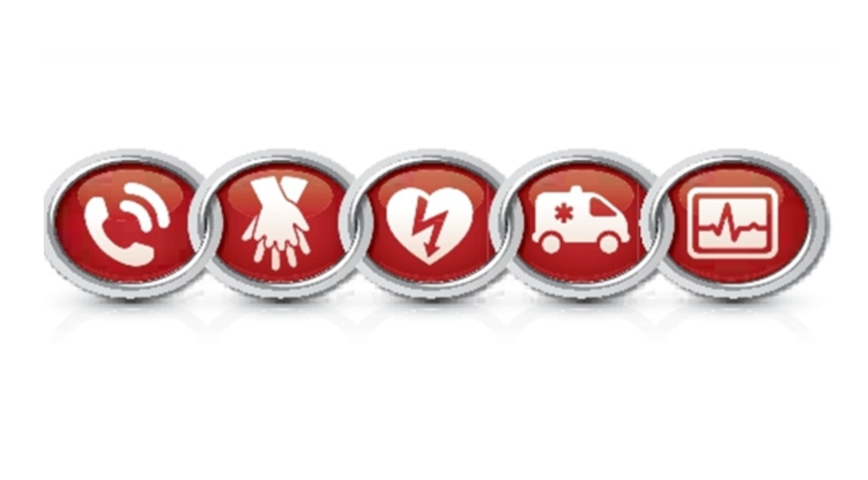
ADULT AND CHILD CHOKING

Slide 4
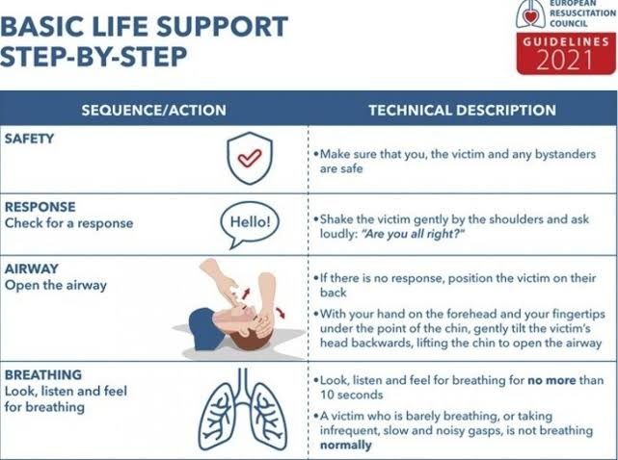
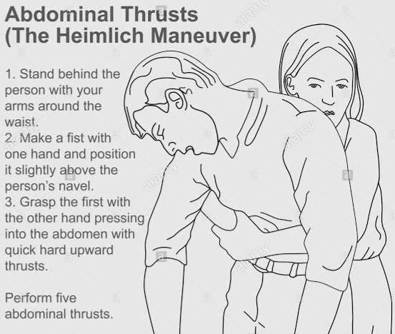
Choking is a common but highly preventable cause of cardiac arrest.
Mild obstruction- if the Individual is breathing, wheezing and coughing, stay with them and encourage them to stay calm and cough.
Severe obstruction- if the individual jas little to no breathing and is making little to no noise, use the Heimlich maneuver amd call EMS.
In unresponsive individuals behin the BLS procedure.

Slide 5
Abdominal thrusts for an adult or child
If you think someone is choking, ask, “Are you choking? Can I help you?”
If the person nods yes, tell them you are going to help.
Stand firmly or kneel behind the person (depending on your size and the size of the person choking). Wrap your arms around the person’s waist so that your fists are in fron.
Make a fist with one hand.
Put the thumb side of your fist slightly above the belly button and well below the breastbon.
Grasp the fist with your other hand and give quick upward thrusts into the abdomen
Give thrusts until the object is forced out and the person can breathe, cough, or speak, or until they become unresponsive.
If the person who has a severe airway block is pregnant or very large, give chest thrusts instead of abdominal thrusts
If you can’t wrap your arms fully around the waist, give thrusts on the chest (chest thrusts) instead of on the abdomen
Put your arms under the armpits and your hands on the lower half of the breastbone
Pull straight back to give chest thrusts

Slide 6
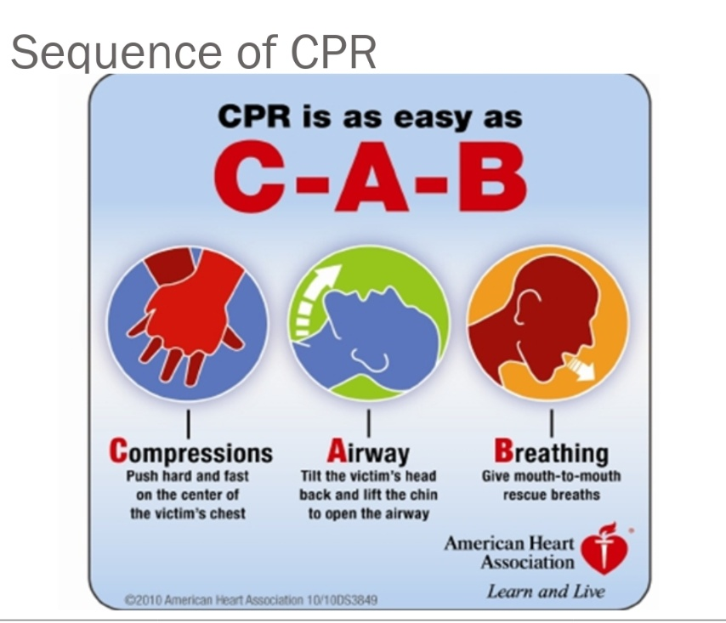
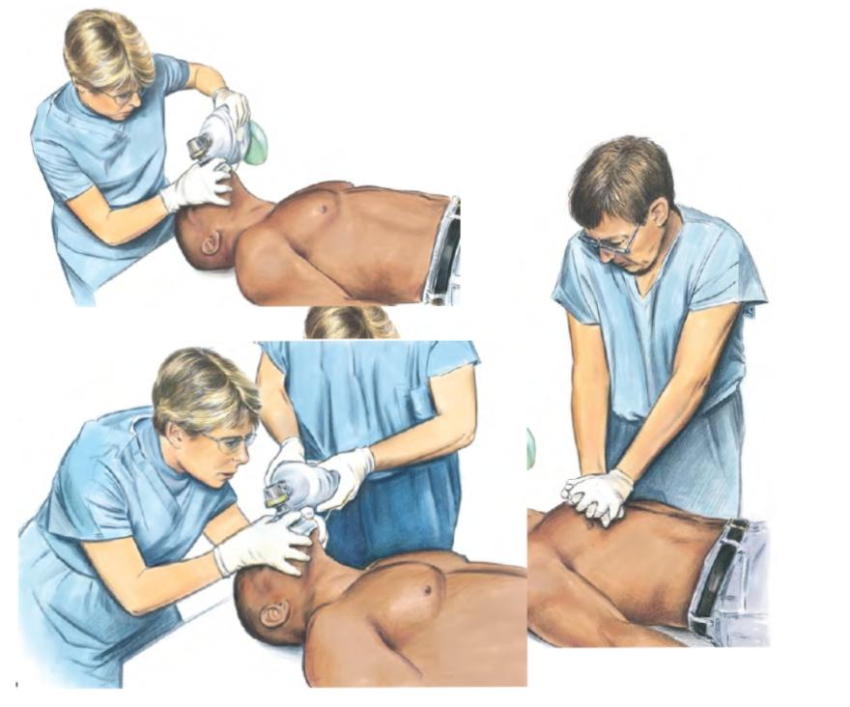
.

Slide 7
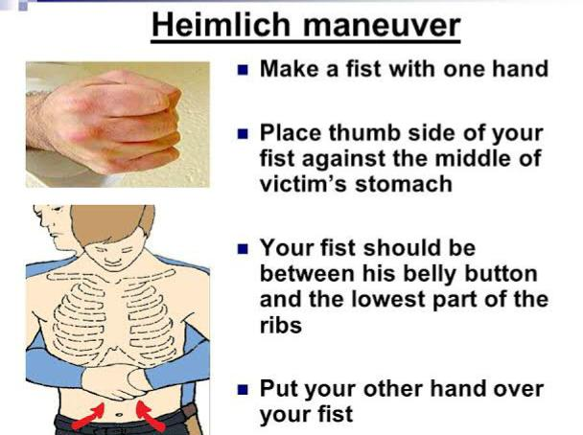
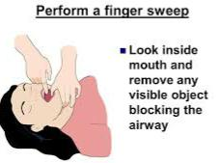
Choking Adult and Child Who Becomes Unresponsive
Shout for help
Phone and get AED
Provide CPR, starting with compressions
After each set of 30 compressions, open the airway to give breaths
Look in the mouth. If you see an object in the mouth, take it out
Give 2 breaths and then repeat 30 compressions
Continue CPR until
The person moves, speaks, blinks, or otherwise reacts
More advanced medical personnel arrive.
Do not perform a blind finger sweep:
Every time you open the airway to give breaths, look for the object in the back of the throat. If you see an object in the
mouth, take it out
Do not perform a blind finger sweep.
This can cause the object to get lodged further back in the airway

Slide 8
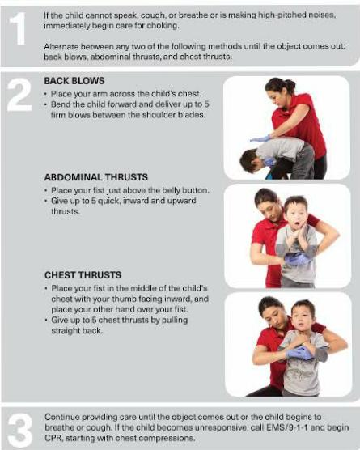
Choking Child or Infant Who Becomes Unresponsive
A child or infant who has a severe airway block and becomes unresponsive needs immediate CPR Shout for help. Make sure the child or infant is lying on their back on a firm, flat surface. Begin CPR, phone 9-1-1, and get AED Provide CPR Give sets of 30 compressions and 2 breaths After each set of 30 compressions, open the airway to give breaths Look in the mouth. If you see an object in the mouth, take it out Give 2 breaths.
The Heimlich maneuver can be performed with the victim standing or lying down.
The hands are positioned slightly above the navel and well below the xiphoid process and then pressed into the abdomen with a quick upward thrust. The maneuver may need to be repeated.
BASIC LIFE SUPPORT( BLS)
CHECK: Scene, victim
CALL : EMS, 123.
CARE:
A: Airway
B: Breathing
C: Circulation

Slide 9
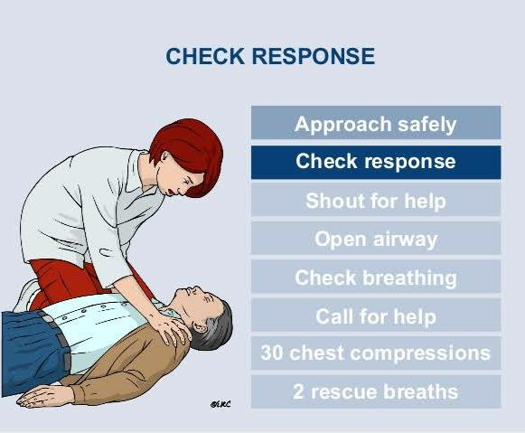
Basic Life Support for Adults and Children
Patient Assessment
Opening the Airway Open the airway before performing rescue breathing
Providing Rescue Breathing
Adult and Child CPR Position yourself and the patient
Choking or Airway Obstruction
Managing Airway Obstruction
Abdominal Thrusts Stand or kneel behind the patient.

Slide 10
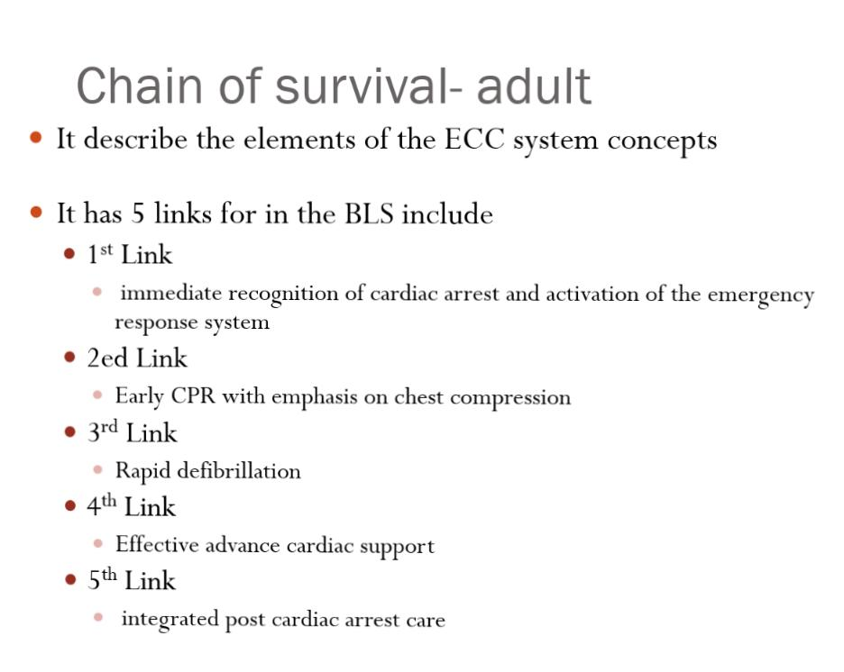
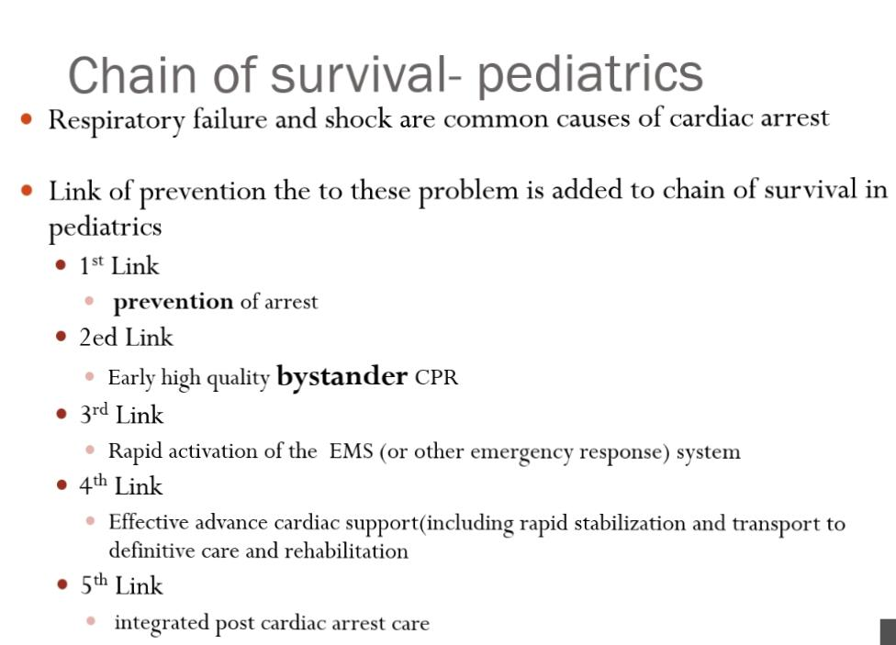

Slide 11
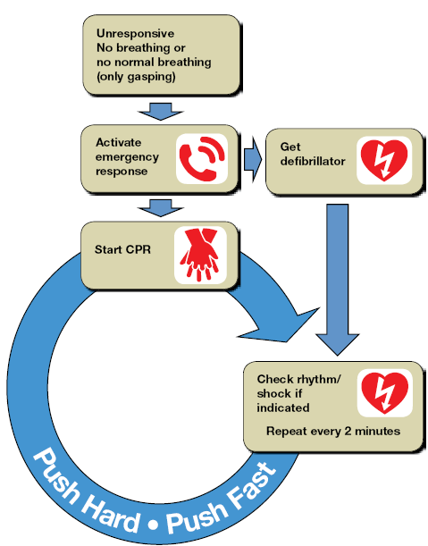
Adult basic life support

Slide 12
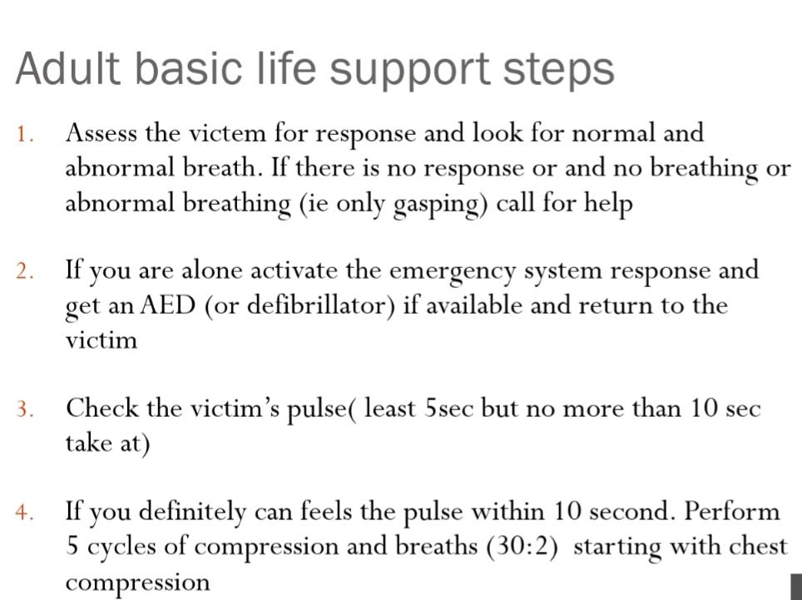
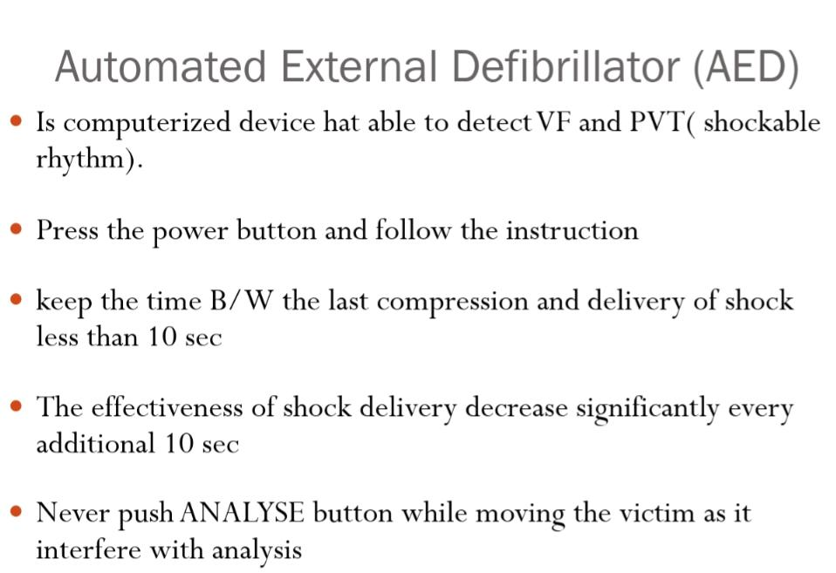

Slide 13
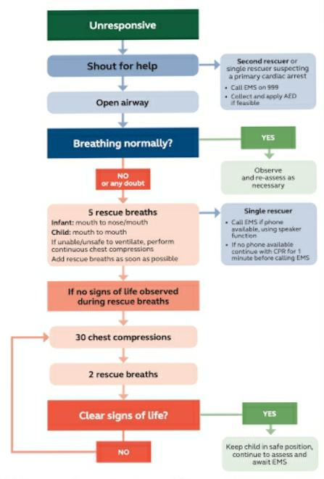
CHILD BASIC LIFE SUPPORT

Slide 14
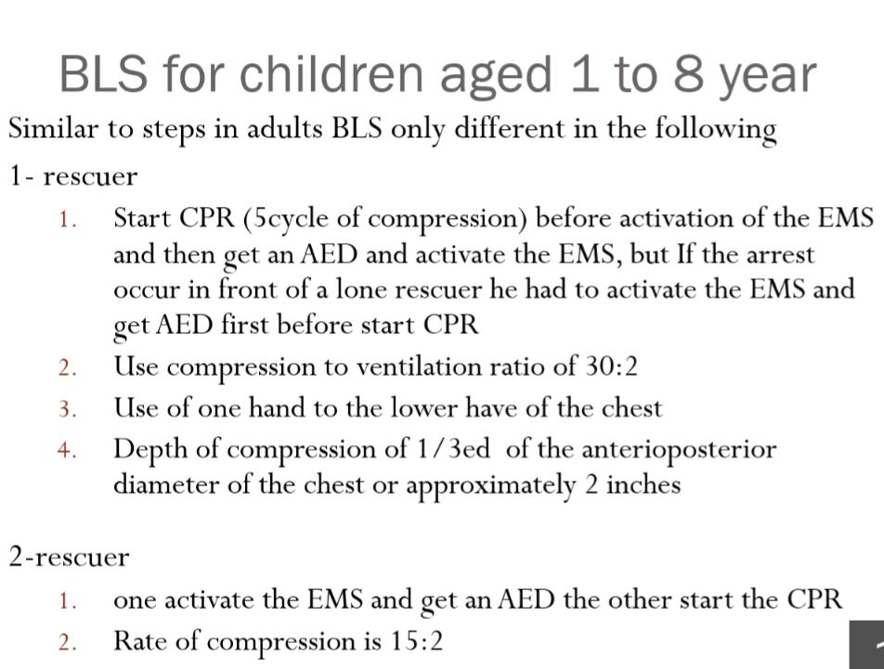
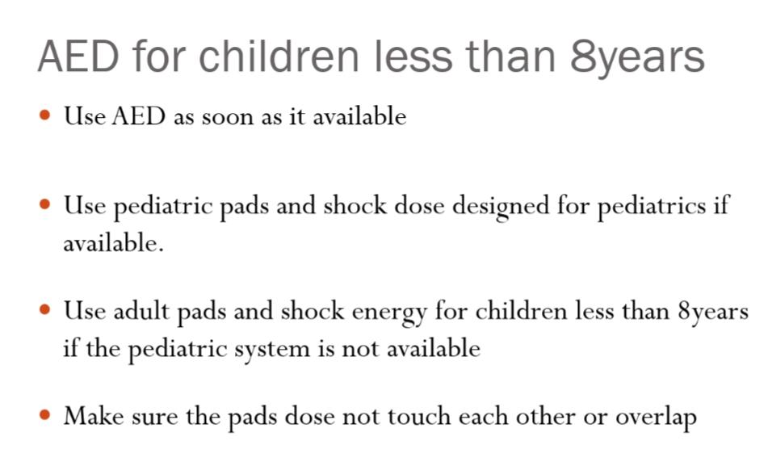

Slide 15
